Slide 1

Software Defects binary Classification using Machine Learning CS 584 – Machine Learning
Anthony Rodriguez (A20547980)
Deshon Langdon (A20503832 )

Slide 2

Problem Statement
Software defects, also known as bugs, are a common occurrence in the software development process.
Early detection of these defects is crucial to prevent such failures and ensure the smooth operation of systems
Lack of detection might be detected until the software is in use.
Very time-consuming and labor-intensive
Difficult to effectively allocate resources for defect management
Scalability and Feasibility issues
Expensive it is to fix after deployment

Slide 3
Proposed Solution & Dataset
Implement various machine learning models for binary classification of software defects. Models include :
Gaussian Naive Bayes, Random Forest Classifier
Bernoulli Naive Bayes, Gradient Boosting Classifier
Decision Tree Classifier, Histogram-based Gradient Boosting Classification Tree
K-Nearest Neighbors Classifier, Light Gradient Boosting Machine
Logistic Regression, Extreme Gradient Boosting
CatBoost Classifier.
Dataset: Binary Classification with a Software Defects Dataset initially containing 101,763 samples. Dataset contained 21 predictors and 1 label column.
Contains 3,662 training (later split into 2,462 training samples, and 1,200 validation samples)
Each row represents a software instance and is labeled under the ‘defects’ column as either ‘False’ (0) or ‘True’ (1), indicating the absence or presence of a software defect.

Slide 4

Proposed Solution & Dataset cont’d
Objective:
Compare the performance of various models to find the most effective model for predicting software defects.
Use the validation set as the test set to evaluate the models’ performances.

Slide 5

Workflow
Data Exploration
Data
Pre-processing
Data
Modelling
Feature selection
Outlier Detection and Standardization
Split dataset into training & validation
Gaussian Naive Bayes
Bernoulli Naive Bayes
Decision Tree Classifier
K-Nearest Neighbours Classifier
InceptionV3
Logistic Regression
Random Forest Classifier
Gradient Boosting Classifier
Histogram-based Gradient Boosting Classification Tree
Checking Missing Values in entries
Checking Duplicates entries
Data Distribution of features and label (defects)
Correlation Analysis

Slide 6
Workflow cont’d
Data
Modelling
Evaluate Results
Data
Modelling
Label validation Data
•Light Gradient Boosting Machine
Extreme Gradient Boosting
CatBoost Classifier
Repeated K-Fold Cross Validation
Evaluation on baseline model
Hyperparameter tuning
Plotting loss and accuracy
Predicting labels for validation data using each optimized model
Model Evaluation on the optimized models

Slide 7
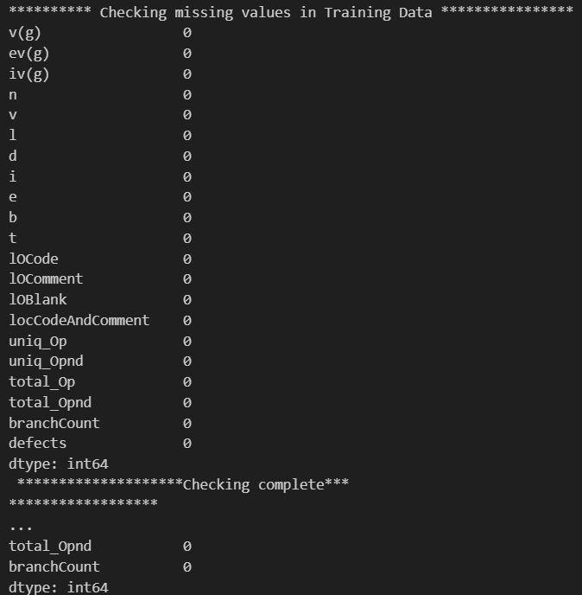
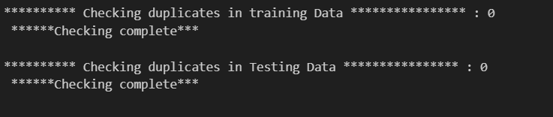
Data Exploration
Both checking missing values duplicates in entries of the dataset give 0 as the results

Slide 8
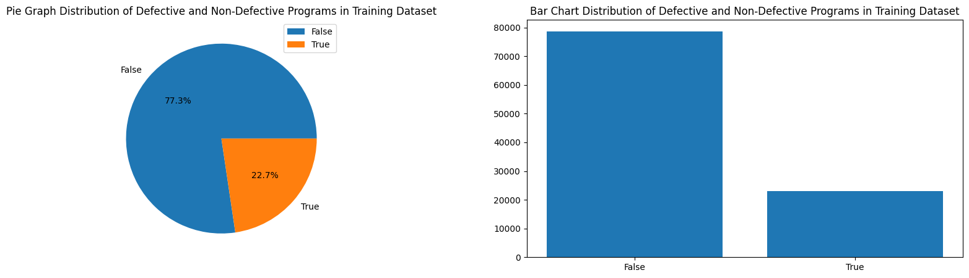
Defects Distribution
Perform visualization of distribution of defective and non-defective programs in the training dataset.
73.33% of data labeled not having defects were remaining 22.7% have defects
Notes:
Perform visualization of distribution of defective and non-defective programs in the training dataset. This helped understand the balance between the two classes in the dataset.

Slide 9
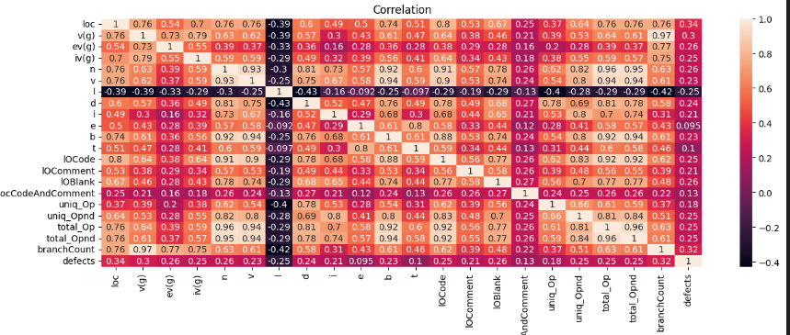
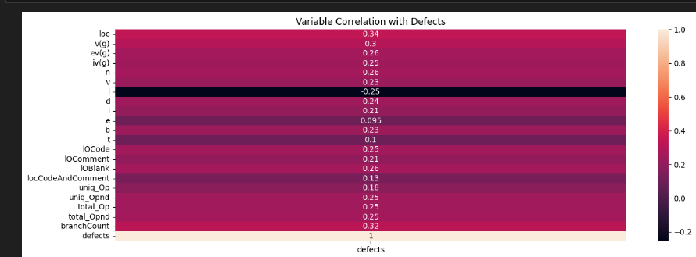
Correlation Analysis

Slide 10
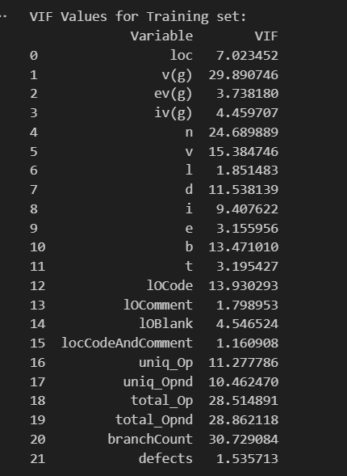
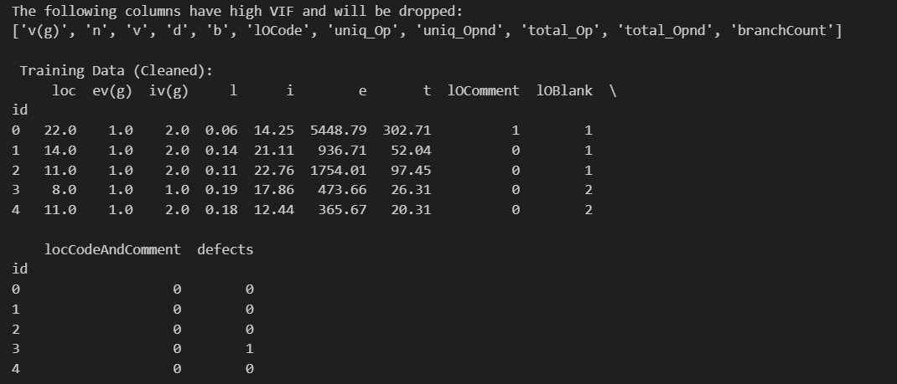
Feature Selection
Perform variance Inflation Factor (VIF) for each feature.
Features with a high VIF are highly correlated with other features and can cause problems in the model, so they are dropped
Notes:
This step involves identifying and removing features that might not be useful for the model. This is done by calculating the Variance Inflation Factor (VIF) for each feature. Features with a high VIF are highly correlated with other features and can cause problems in the model, so they are dropped.

Slide 11
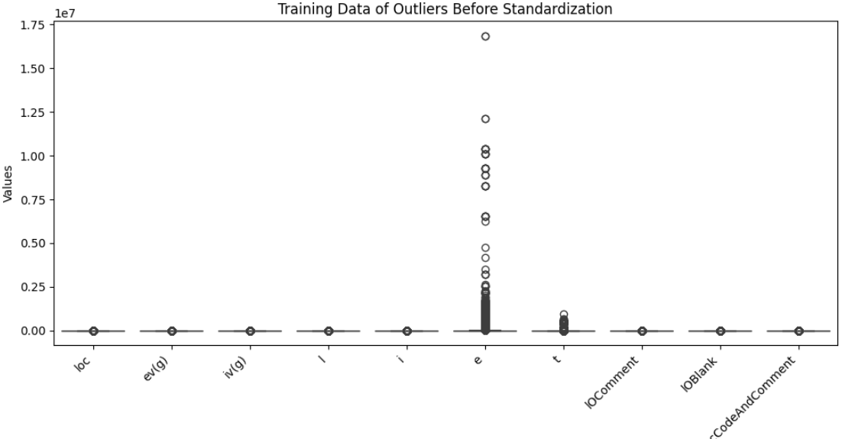
Outlier Detection and Standardization (Before)
Notes:
This step involves identifying and handling outliers in the data. Outliers are extreme values that can skew the model’s performance. The data is also standardized to have a mean of 0 and a standard deviation of 1. This ensures that all features are on the same scale and helps the model to converge faster

Slide 12
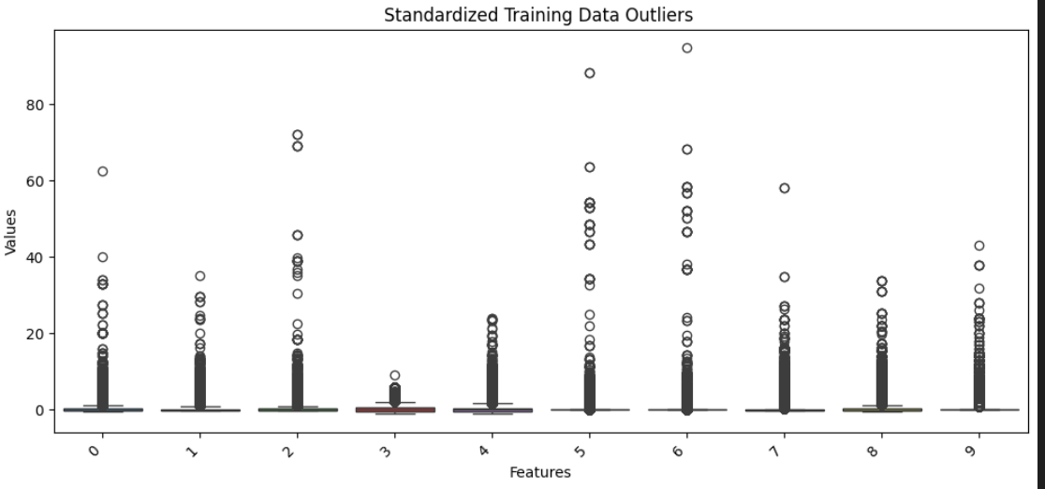
Outlier Detection and Standardization (After)
Notes:
This step involves identifying and handling outliers in the data. Outliers are extreme values that can skew the model’s performance. The data is also standardized to have a mean of 0 and a standard deviation of 1. This ensures that all features are on the same scale and helps the model to converge faster

Slide 13
Data Modeling
Implement a Cross Validation Strategy for Evaluating Each Model:
Gaussian Naive Bayes
Bernoulli Naive Bayes
Decision Tree Classifier
Classification Tree
K-Nearest Neighbors Classifier
Logistic Regression
CatBoost Classifier
Implemented Cross Validation using Repeated Stratified K Fold Sampling (5 folds and 5 Repeats)
Evaluated Each Model Based Upon:
Accuracy:
Percentage of observations correctly classified.
ROC AUC Score:
Probability that the model can distinguish between positive and negative classes.
F1 Score:
Harmonic Mean of Precision and Recall Scores
2*(Precision*Recall)/(Precision+Recall)
Random Forest Classifier
Gradient Boosting Classifier
Hist Gradient Boosting
Light Gradient Boosting
Extreme Gradient Boosting

Slide 14
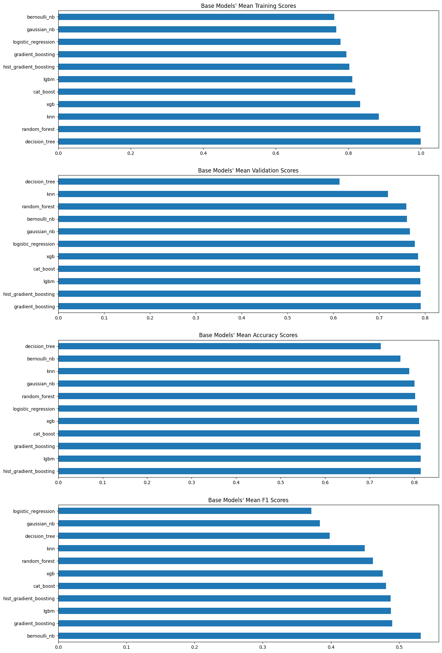
Base Model Results

Slide 15
Base Model Results
Model Name | Ave. Training ROC AUC Score | Ave. Validation ROC AUC Score | Ave. Accuracy | Ave. F1 Score
Gaussian NB | 0.7671589 | 0.7671437 | 0.8006672 | 0.3837027
Bernoulli NB | 0.760931 | 0.7608771 | 0.7692737 | 0.5317257
Decision Tree | 0.9995711 | 0.6138554 | 0.7248548 | 0.3985115
KNN | 0.884046 | 0.7194356 | 0.7890225 | 0.4495136
Logistic Regression | 0.7781648 | 0.7780576 | 0.8067461 | 0.3711798
Random Forest | 0.9985411 | 0.759114 | 0.8024754 | 0.461492
Gradient Boosting | 0.7948394 | 0.7906932 | 0.8146203 | 0.4898802
Hist Gradient Boosting | 0.8028327 | 0.7906572 | 0.8147686 | 0.4876493
LGBM | 0.810897 | 0.7903612 | 0.8147549 | 0.4881741
XGB | 0.8323212 | 0.7849803 | 0.8113244 | 0.4759125
Cat Boost | 0.8193732 | 0.7892677 | 0.8130283 | 0.4809887

Slide 16
Hyper Parameter Tuning
Gaussian Naive Bayes Variance Smoothing Portion of the largest variance of all features that is added to variances. Decision Tree Criterion Function to Measure Quality of Split Max Tree Depth K Neighbor Classifier Neighbors Number of Neighbors Logistic Regression Solvers Optimization Algorithm C Values Inverse Regularization Strength | Bernoulli Naive Bayes Alpha Additive Smoothing Parameter Random Forest Max Tree Depth Max Features Number of Features to Consider for Best Split Hist Gradient, Gradient Boosting, & Extreme Gradient Boosting Max Tree Depth Learning Rate Cat Boosting Max Tree Depth Light Gradient Boosting Machine Max Tree Depth Max Number of Leaves Max Number of Leaves Per Tree

Slide 17
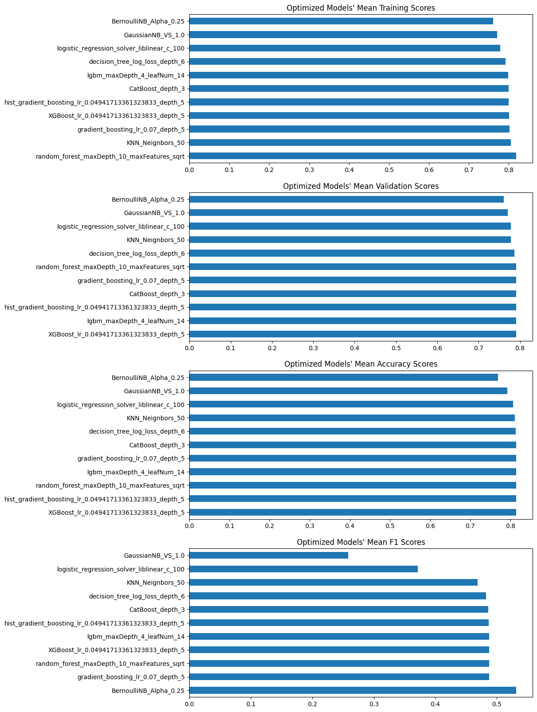
Optimized Model Results

Slide 18
Optimized Model Results
Model Name | Ave. Training ROC AUC Score | Ave. Validation ROC AUC Score | Ave. Accuracy | Ave. F1 Score
GaussianNB_VS_1.0 | 0.7703925 | 0.7703802 | 0.7925759 | 0.2587808
BernoulliNB_Alpha_0.25 | 0.7609309 | 0.7608771 | 0.7692737 | 0.5317257
decision_tree_log_loss_depth_6 | 0.7916948 | 0.7865117 | 0.8135423 | 0.4824395
KNN_Neignbors_50 | 0.8051304 | 0.7781011 | 0.8117106 | 0.4686465
logistic_regression_solver_liblinear_c_100 | 0.7781662 | 0.7780591 | 0.80675 | 0.3712207
random_forest_maxDepth_10_maxFeatures_sqrt | 0.8188424 | 0.790596 | 0.8148463 | 0.4876912
hist_gradient_boosting_ lr_0.04941713361323833_depth_5 | 0.7995138 | 0.7910308 | 0.8148699 | 0.4870412
lgbm_maxDepth_4_leafNum_14 | 0.7983258 | 0.7911049 | 0.8146743 | 0.4876798
gradient_boosting_lr_0.07_depth_5 | 0.8023741 | 0.7909673 | 0.8146645 | 0.4877596
XGBoost_lr_0.04941713361323833_depth_5 | 0.800319 | 0.7911931 | 0.814921 | 0.4876838
CatBoost_depth_3 | 0.7994325 | 0.791019 | 0.8144041 | 0.4859718

Slide 19
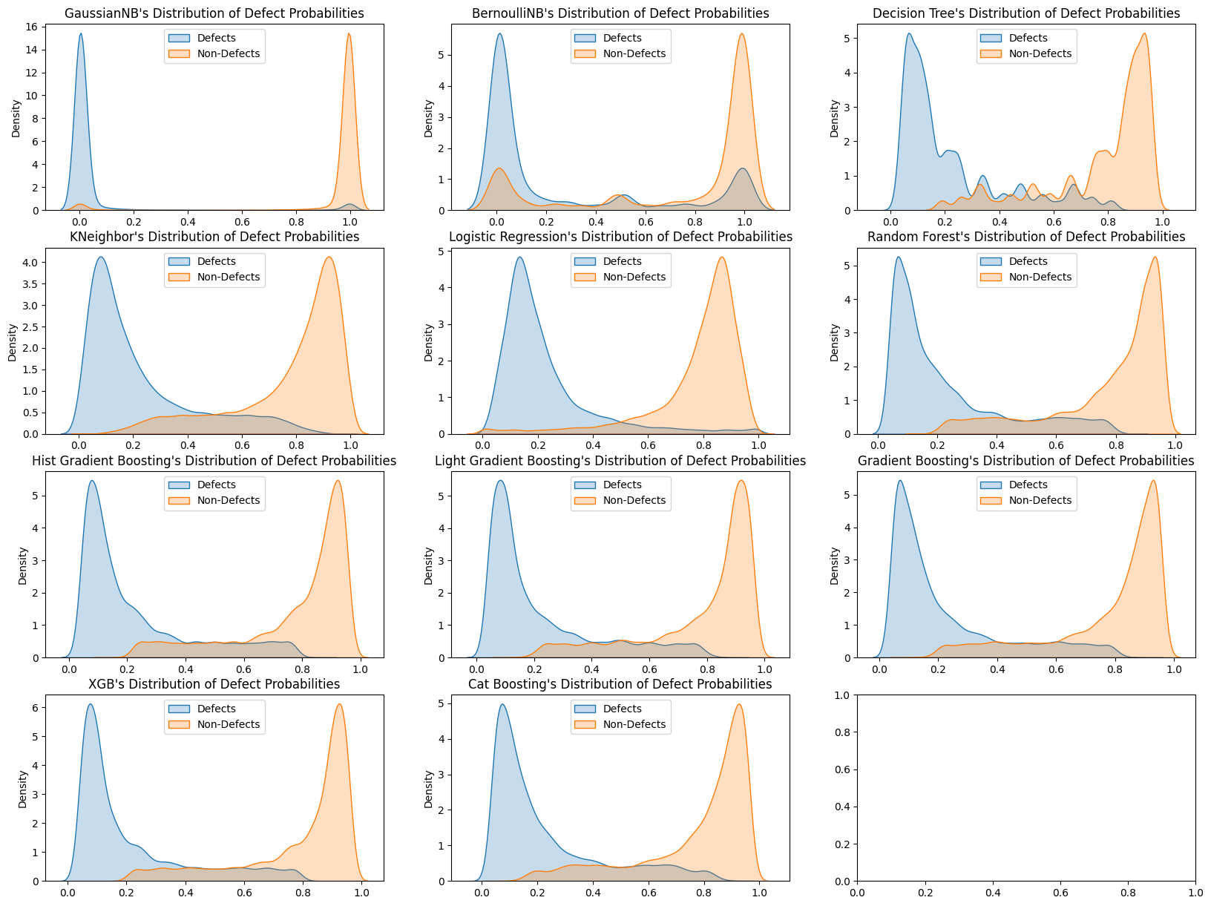
Optimized Model Testing Data Defect Probabilities

Slide 20
Planned Future Work
Implementing a Custom Classifier Ensemble Based Upon Our Data To Improve Results.
Evaluate Our Data Preprocessing Methods To Better Optimize Our Models.
Evaluate Our Model Performance Metrics For Better Selection and Optimization of Models.

Slide 21


